Slide 1

CONTROL SYSTEMS
PROJECT TITLE : SMART HOUSE
Group members :
D VISHAL – S20190020210
K LITHEESH KUMAR – S20190020218
K SREENIVASULU REDDY – S20190020217
KVSS PAVAN TEJA - S20190020216
COURSE INSTRUCTOR
HRISHIKESH
VENKATARAMAN

Slide 2
MOTIVATION
TO SAVE THE WATER
TO SAVE THE ELECTRICITY
TO MAKE THE HUMAN LIFESTYLE BETTER AND EASIER
PEOPLE ARE MORE INTERESTED ON WIRELESS EMBEDDED SYSTEMS, TO MAKE THE FUTURE LIFESTYLE BETTER.

Slide 3
PUMP MOTOR
BLOCK DIAGRAM
WATER TANK
CAR SHUTTER
BUZZER
ULTRASONIC SENSOR
DOOR LOCK
ARDUINO
BLUETOOTH MODULE
LIGHT
FAN

Slide 4
DOOR LOCK
A BLUETOOTH BASED DOOR LOCK SYSTEM IS FIXED IN THE HOME
BASED ON THE ENTRY OF INPUTS, LOCKING AND UNLOCKING OF THE DOOR HAPPENS
IF THE ENTRY IS D – DOOR WILL BE UNLOCKED
IF THE ENTRY IS d – DOOR WILL BE LOCKED

Slide 5
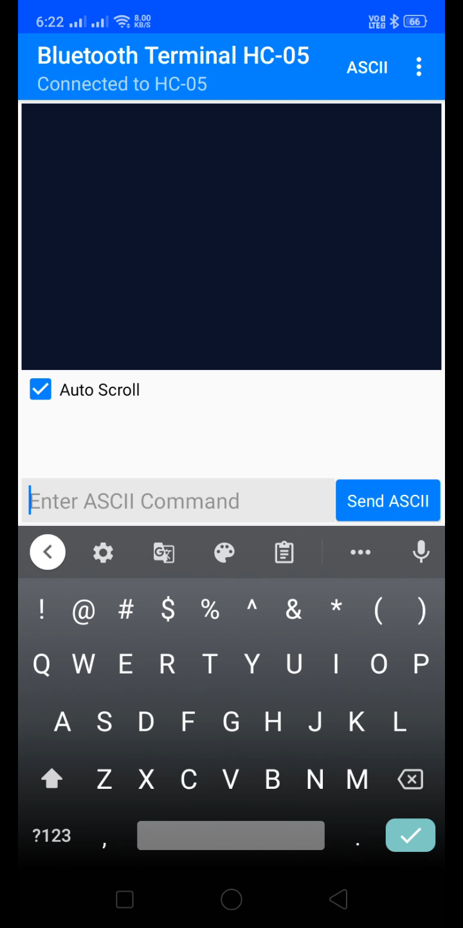
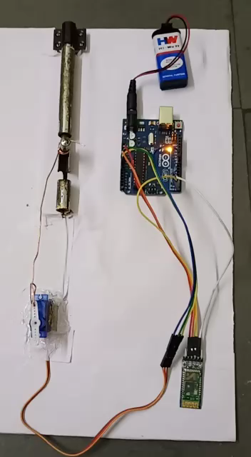

Slide 6
FAN AND LIGHT
A BLUETOOTH BASED FAN AND LIGHT SYSTEM IS FIXED IN THE HOME
BASED ON THE ENTRY OF INPUTS, TURNING ON AND OFF OF THE LIGHTS AND FAN HAPPENS
IF THE ENTRY IS F – FAN WILL BE TURNED ON
IF THE ENTRY IS f – FAN WILL BE TURNED OFF
IF THE ENTRY IS L – LIGHT WILL BE TURNED ON
IF THE ENTRY IS l – LIGHT WILL BE TURNED OFF

Slide 7
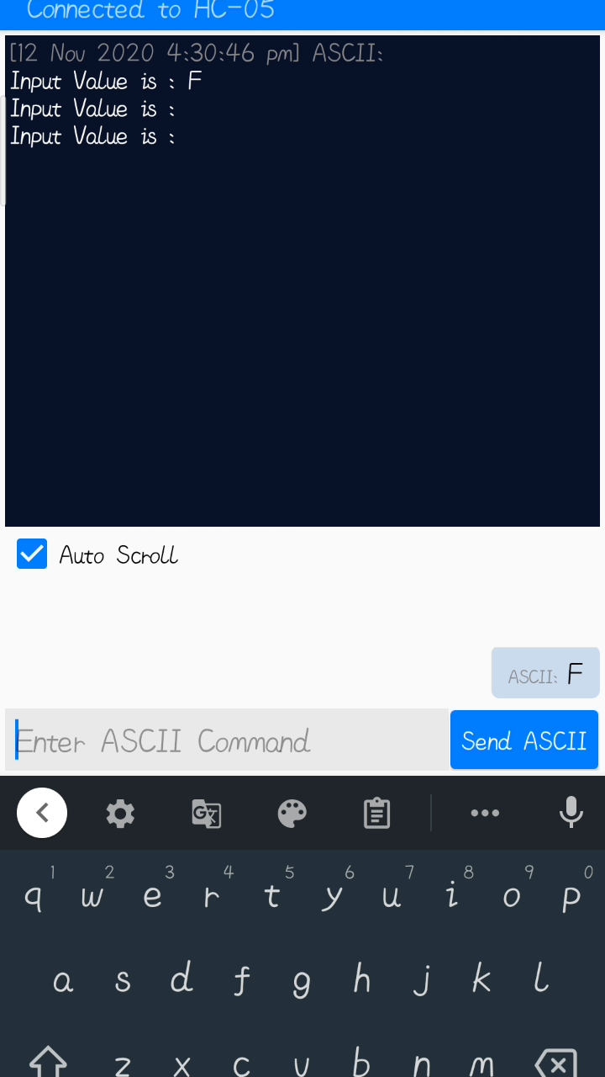
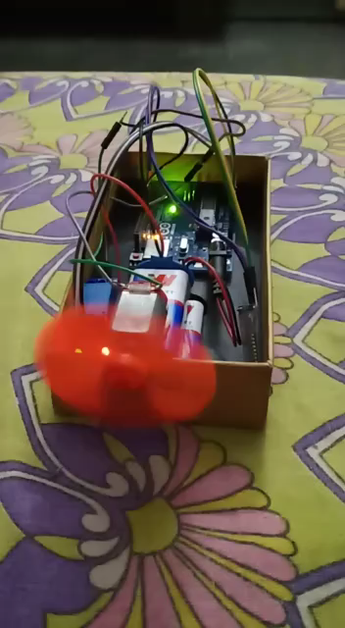

Slide 8
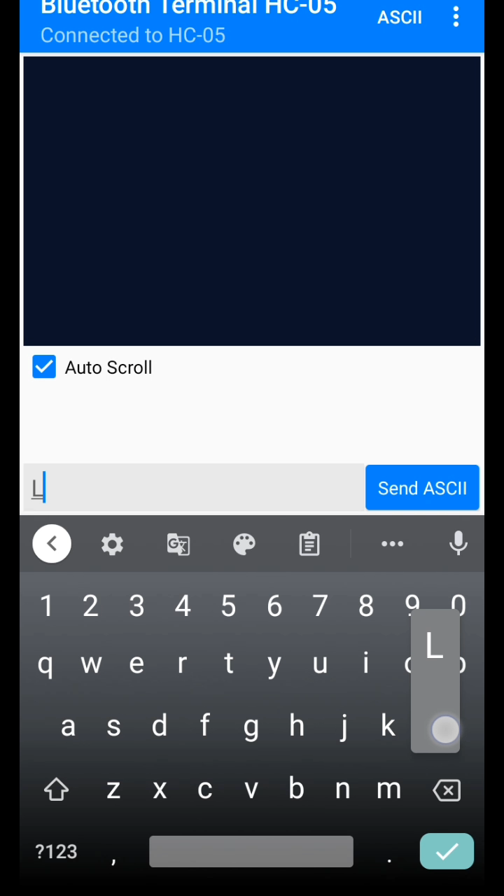
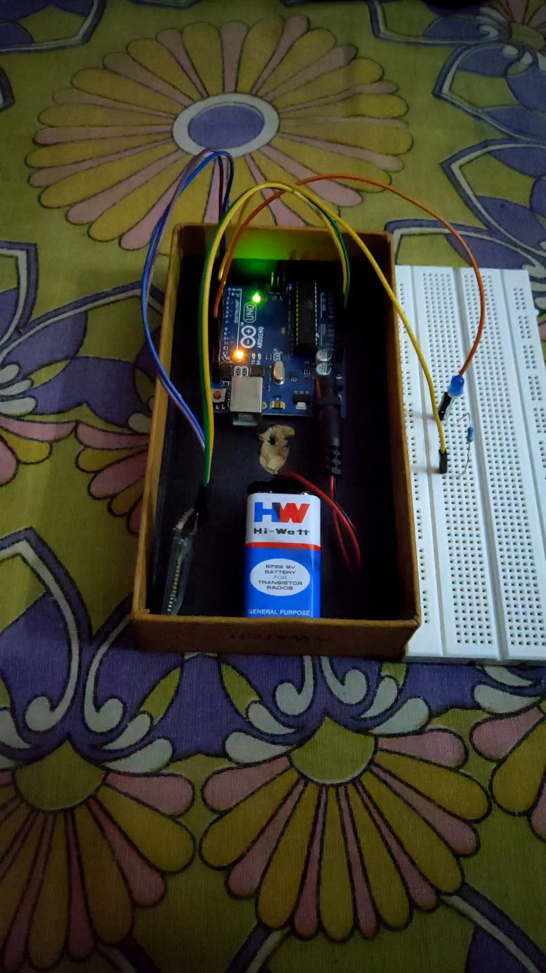

Slide 9
CAR SHUTTER
AN ULTRA SONIC SENSOR IS FIXED ON THE SHUTTER
WHEN THE CAR IS ARRIVED, SENSOR READS THE DISTANCE BETWEEN CAR AND SHUTTER
BASED ON THE DISTANCE THE SHUTTER WILL BE LIFTED UP accordingly

Slide 10
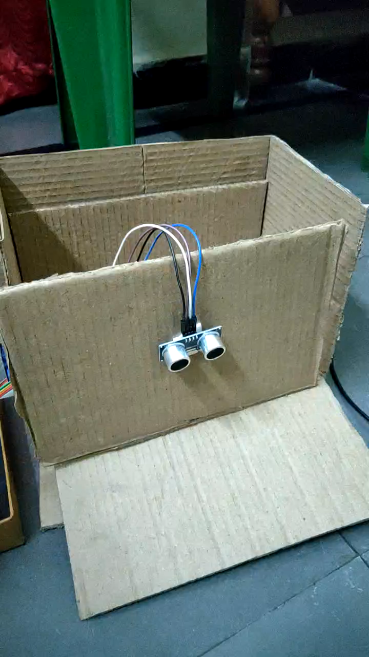

Slide 11
WATER TANK WITH PUMP MOTOR
WE HAVE A MANUAL SWITCH BASED PUMP MOTOR
WATER WILL BE PUMPED INTO THE WATER TANK WHEN THE SWITCH IS ON
THE LEVEL OF WATER IS INDICATED ON A PANEL WHERE SOME LED’S ARE FIXED
IF THE TANK IS GETTING FILLED, A NOTIFICATION TYPE BUZZER SOUND IS PRODUCED, SO THAT WE CAN TURN OFF THE SWITCH TO SAVE WATER

Slide 12
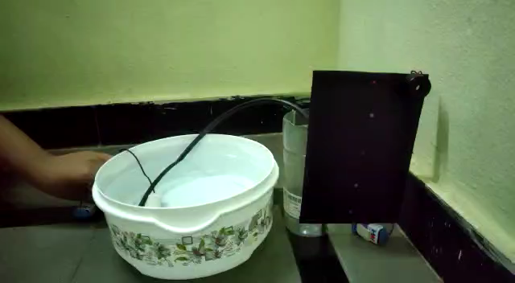

Slide 13
CHALLENGES ANTICIPATED
FACED DIFFICULTY IN COMBINING THE SUB PARTS OF THE PROJECT
FACED DIFFICULTY IN FIXING THE DOOR LOCK
FACED DIFICULTY IN CAR DOOR SHUTTER

Slide 14
EXPECTED RESULT IN FINAL VIDEO
WE WILL HAVE A MANUAL PUMP MOTOR WHERE WE CAN TURN ON OR TURN OFF THE PUMP MOTOR BASED ON THE LEVEL OF WATER IN THE TANK
WE WILL HAVE A BLUETOOTH BASED DOOR LOCK SYSTEM
WE WILL HAVE A BLUETOOTH BASED FAN AND LIGHT WHERE SWITCHING ON AND OFF THE LIGHTS AND FANS ARE CONTROLLED THROUGH MOBILE
WE WILL HAVE A ULTRA SONIC SENSOR BASED CAR SHUTTER, WHERE ULTRASONIC SENSOR SENSES THE DISTANCE BETWEEN THE CAR AND SHUTTER, BASED ON THE DISTANCE CAR SHUTTER WILL BE LIFTED

Slide 15
THANK YOU

